Slide 1

This Photo by Unknown Author is licensed under CC BY-SA-NC

Slide 2


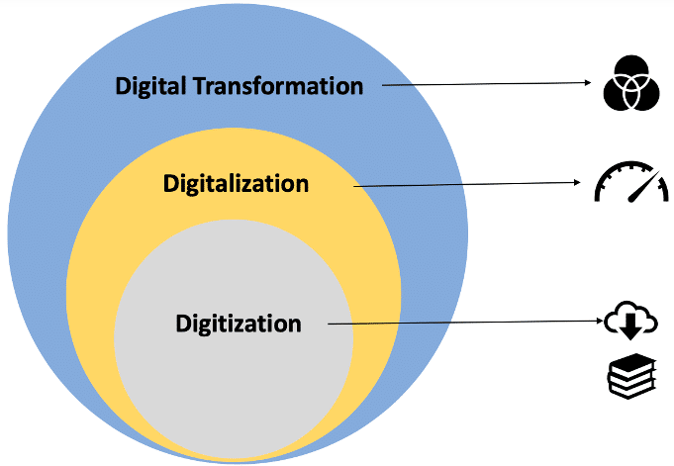
Objective
To achieve penetration of digital technology into all spheres of shipboard usage of logbooks and checklists and accomplish digitalization – paperless ship operation.

Slide 3
Ship Data Management System
Manuals
Forms
Logbooks
Checklist
Deck and Engine Logbook
Cargo and Official Logbook
MARPOL
Logbooks
Navigation, Cargo & Technical (Engine)
e-Deck & Engine Logbook
Morse Platform
+
SMARTSHIP
+
DocMap
e- Logbook
Prevention at Sea and Morse Platform
E-Checklist
SMARTSHIP
+
DocMap
DocMap
e-Forms

Slide 4
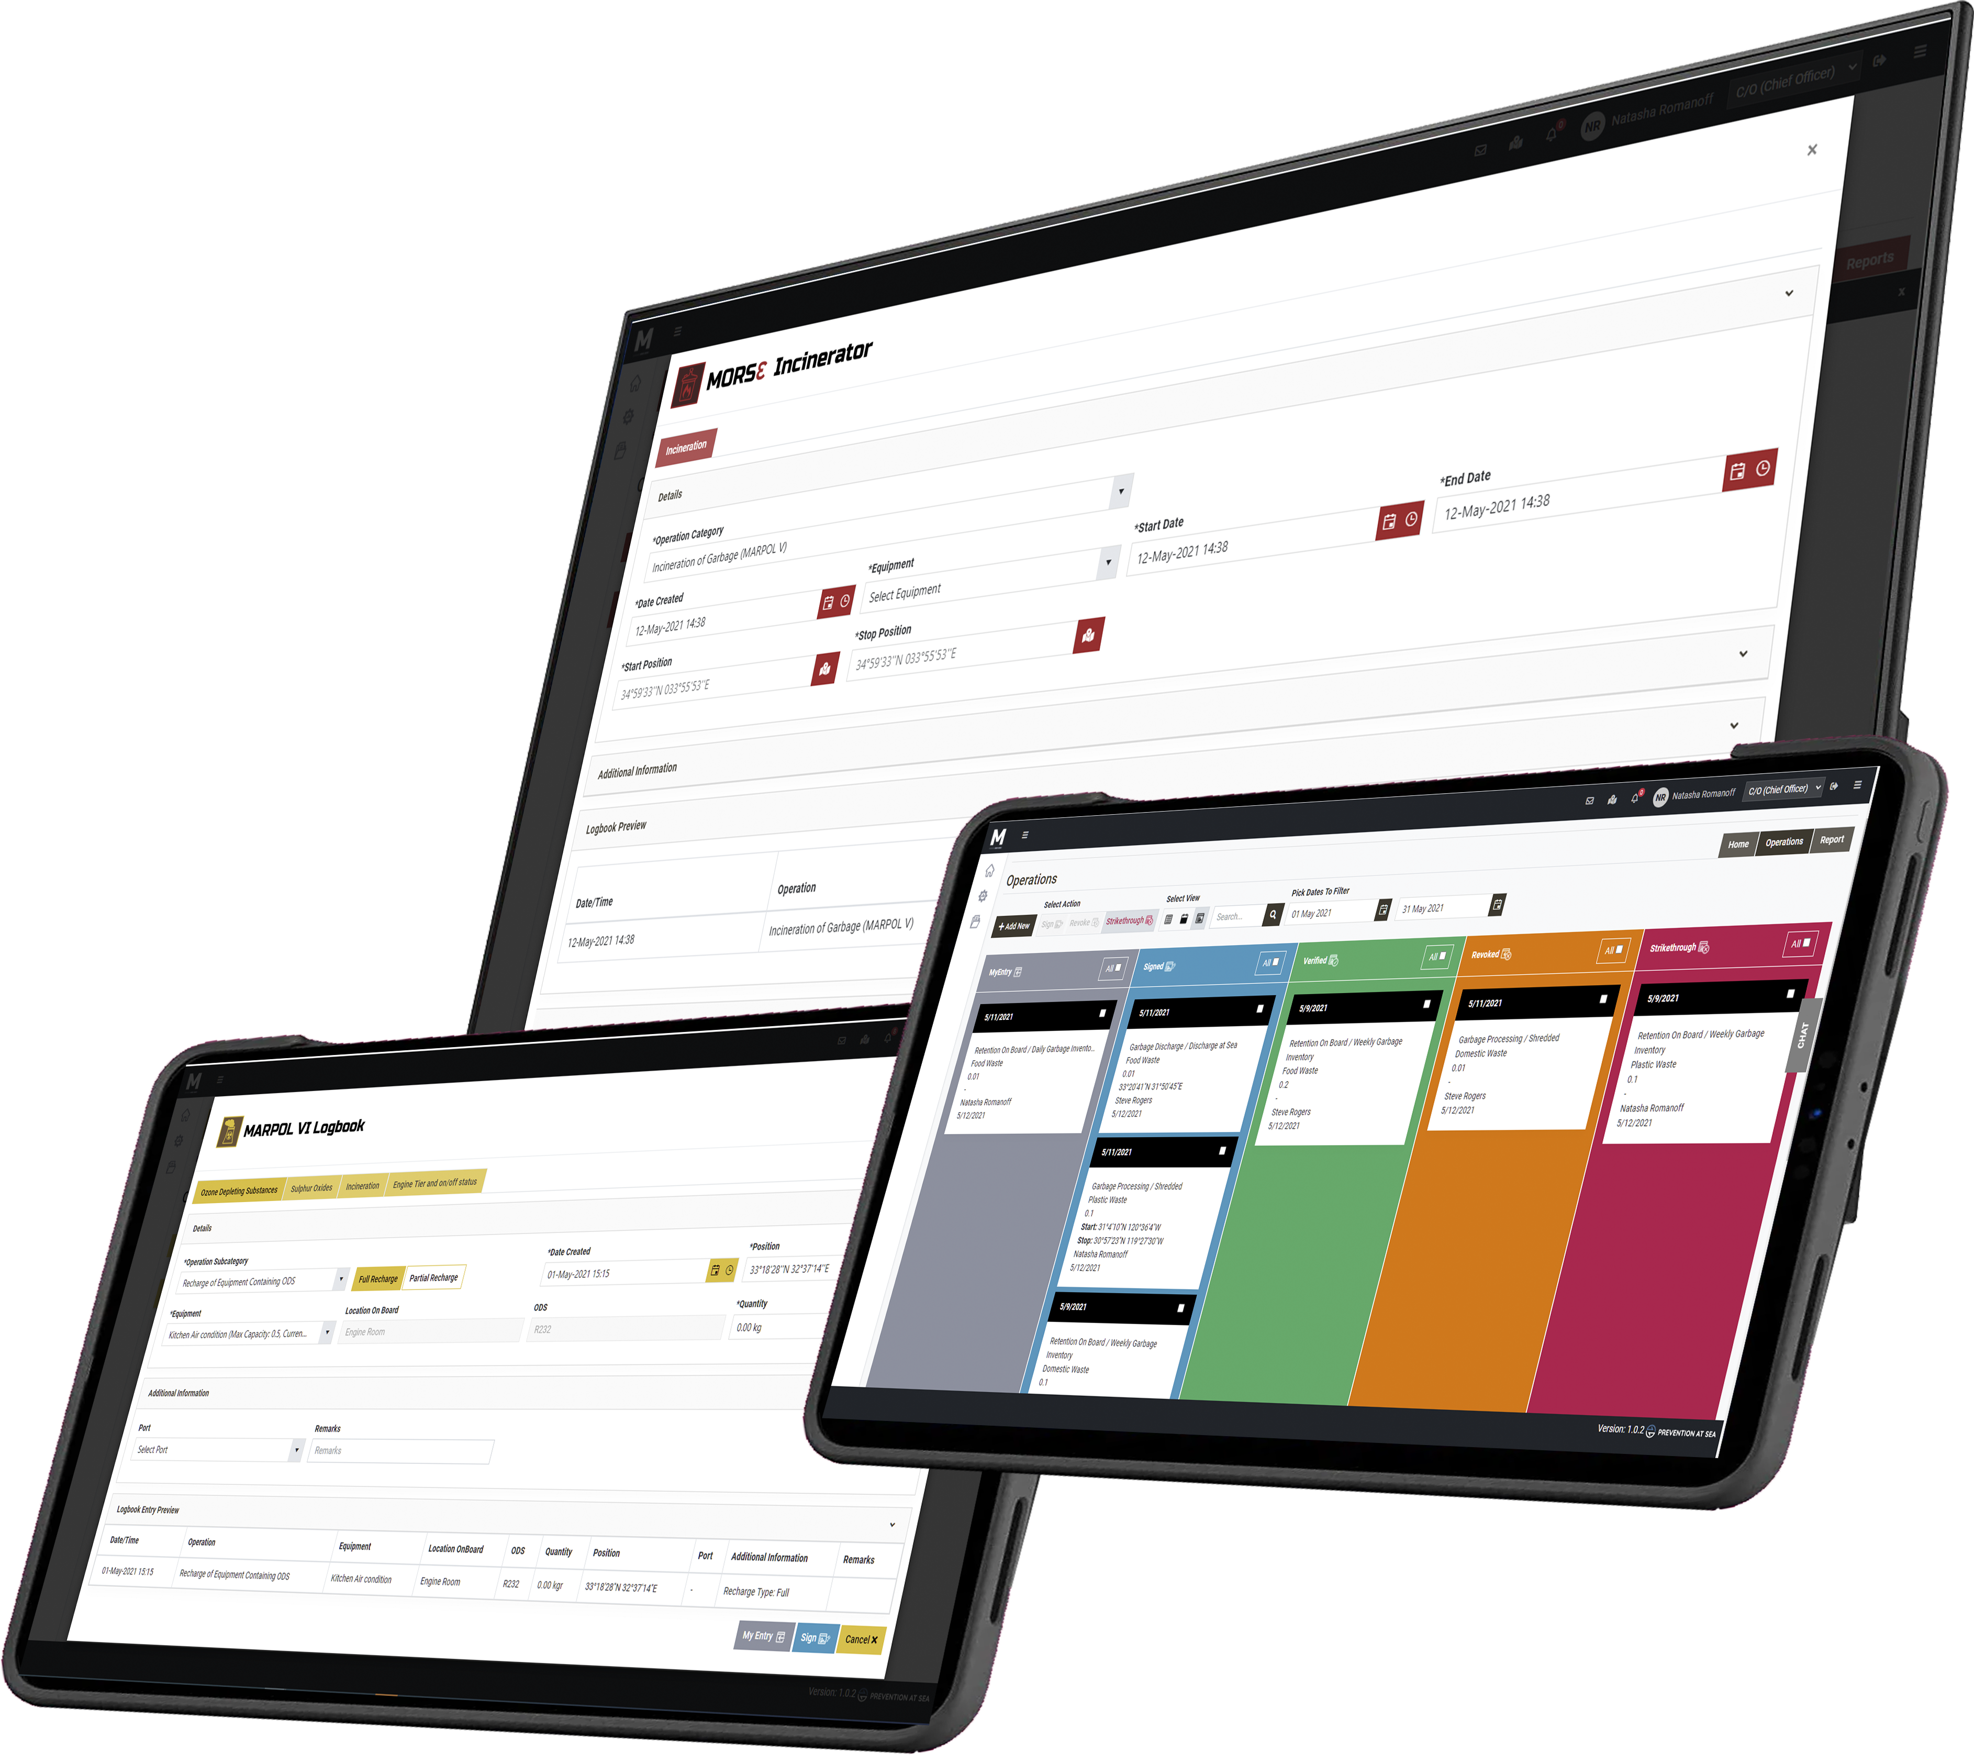
e-Logbooks
ε-record/log Book | Developed | Reviewed & Ready for implementation | Remarks
ORB part I / part II / part III (Panama vessels) | Yes | Yes | Available on Prevention at Sea Platform
Garbage log book Part I & Part II (MARPOL Annex V) | Yes | Yes | Available on Morse Platform
Ozone depleting substances, MARPOL Annex VI | Yes | Yes | Available on Morse Platform
Bunkering, MARPOL Annex VI | Yes | Yes | Available on Morse Platform
Fuel Oil changeover, MARPOL Annex VI | Yes | Yes | Available on Morse Platform
Fuel Oil sampling and custody transfers, MARPOL Annex VI | Yes | Yes | Available on Morse Platform
VOC, MARPOL Annex VI | Yes | Yes | Available on Morse Platform
Tier and on/off status of marine engines, MARPOL Annex VI | Yes | Yes | Available on Morse Platform
Incinerator log book | Yes | Yes | Available on Morse Platform
Engine parameters | Yes | Yes | Available on Morse Platform
Biofouling log book | Yes | Yes | Available on Morse Platform
Ballast Water Record book | Yes | Yes | Available on Morse Platform
Deck log book | In progress | Expected: Q4-2022 | Will be integrating with SMARTSHIPS and DocMap
Engine log book | In progress | Expected: Q4-2022
Official log book | In progress | Expected: Q3-2022 | Will be launched on Morse Platform

Slide 5
e-Logbooks
ε-ORB promotes transparency, credibility, traceability and guards against practical ORB issues such as:
Discrepancies between entry into the ORB and actual capacity of the OWS
Failure to document entries of internal transfer of oily mixtures
Recording of vague entries and mistakes
Risk of lawsuits and criminal charges
Falsification of log entries
Missing oil record book
Administrative burden
MORSƐ - Features
Maritime Operations Records Suite for Ɛ-logs
Dashboards & benchmarking
Dive-in dashboards
Advanced analytics, statistics, diagnostics
Comparison between sister ships based on their performance
EEXI & decarbonization metrics
Data input
Data input from ship’s equipment and machinery (GPS, tank level, temperatures, pressure etc)
Integration with other systems
API calls
Communication
Live chat between fleet and office at the touch of a button
Easy distribution of company’s bulletins/circulars
Sync & data encryption
iSεA web portal for office
Intelligent ship electronics analytics
Data sync / real-time ε-ORB data monitoring
Dive-in dashboards
Detection of uncommon recorded operations based
on sequence or frequency
Benchmarking & diagnostics enabling efficient & timely
decision making
Data comparison between ships
Automated notifications & alerts
Customized reports
Mobile responsive
Expected development; iSEA mobile app

Slide 6




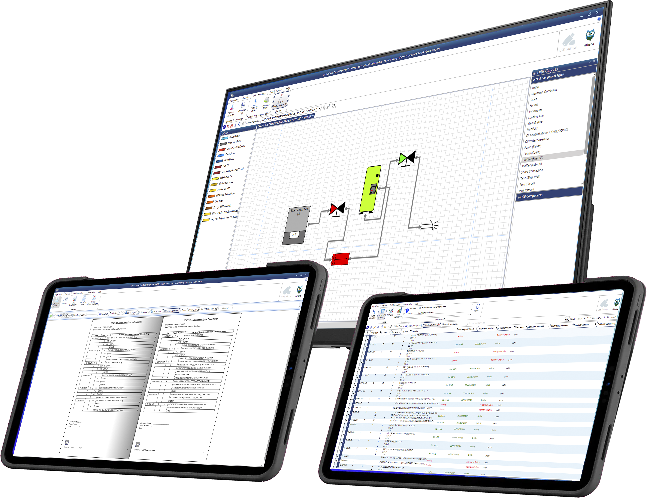
e-Logbooks key points
Compliant with MEPC 312(74), LR/ClassNK/CCS certified
Liberia registry official ε-ORB
Accepted by flag registries
Integration with Rivertrace SMARTSAFE (SENSEAS)
Sounding tables and piping diagrams modules
Seals inventory & daily sounding modules
Ship-specific customization
Automated calculations
Maintenance and support plan
Role based access
Backup system
Data security
Support 24/7

Slide 7
e-Checklist
Problem Statement on existing paper checklists:
Simplify existing checklist
Remove duplications
Prevent information fatigue (eliminate bulky & exhaustive narration)
Cost & effort – logistic challenges
Difficult to inculcate revisions
Solution and Benefits of e-Checklist:
Impactful
Actual compliance
Layered and filtered information
Integrate with DocMap and SMARTSHIPs – AI enabled, notification to comply with checklist
High data quality
Transparency

Slide 8
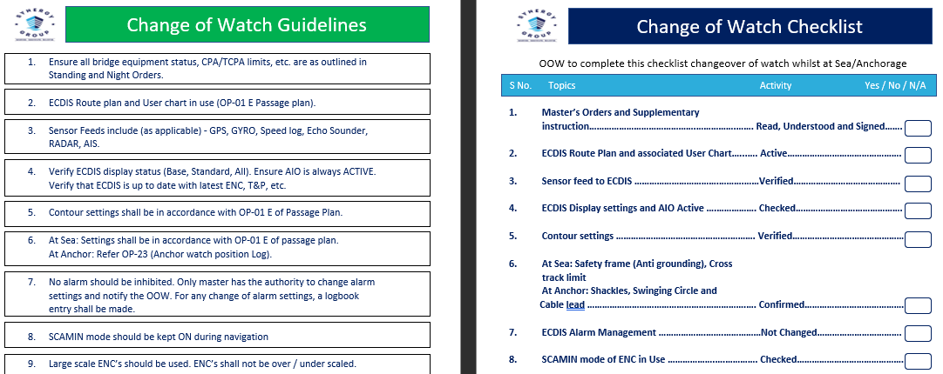
e-Checklist
Checklist | Developed | Reviewed & Ready for implementation | Remarks
Navigation | Yes | Once DocMap is enabled on all vessels | In the interim launching in laminated book format
Cargo | In progress | Expected: Q3-2022 | Will be available on DocMap platform
Technical/Engine Room | In progress | Expected: Q4-2022 | Will be available on DocMap platform
Glimpse of laminated Navigation e-Checklist
“Checklist” consists of key action points that require to completed by the OOW/bridge team, whereas “Guidelines” elaborate the action points, that can be referred as & when required.

